Slide 1
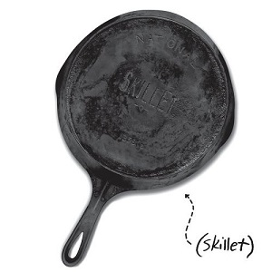
Knights of Columbus
Lenten
Fish Fry
$16
Deep-Fried or Broiled Cod
with Coleslaw and Baked Potato
Every Friday during Lent
February 24th through April 7th
4 PM to 7 PM
Dine-In or Takeout
Reservations for parties 8 and over only.
952-888-1492, Option 1 reservations@becmn.com
Marian Council Bloomington/Richfield

